Slide 1
Graph Attention Networks lecture-8 Course on Graph Neural Networks (Winter Term 20/21)
Prof. Dr. Holger Giese (holger.giese@hpi.de)
Christian Medeiros Adriano (christian.adriano@hpi.de) - “Chris”
Sona Ghahremani (sona.ghahremani@hpi.de )

Slide 2
Quick recap
Metrics
Classification
Random Walk
Node and Graphs Embeddings
Graph Structure Learning
Graph Convolutional Networks
Why do we need Graph Attention Networks?
We need a way to scale without having to make large random walks in the graph

Slide 3
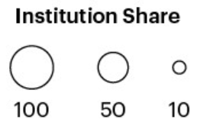
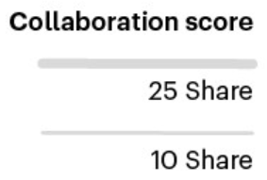
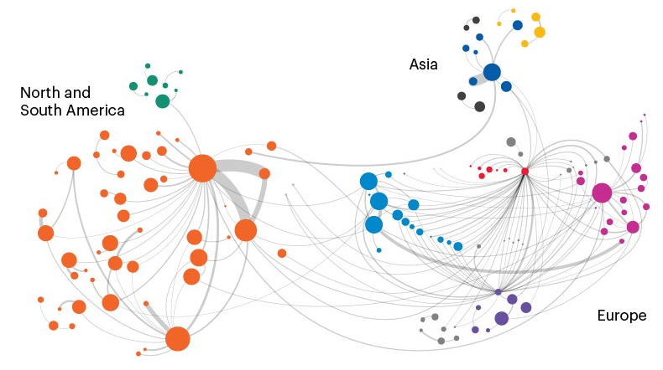
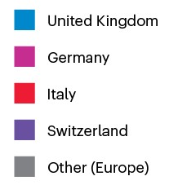
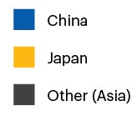
Network effect – AI connections in Natural Sciences
National Institute Of Nuclear Physics
Harvard
UC San Francisco
Max Planck Society
MIT
UC Berkely
Helmholtz Association of German Research Centers
UC Los Angeles
CERN
Stanford
Network effect: visualizing AI connections in the natural sciences, 2020
https://www.nature.com/articles/d41586-020-03410-1

Slide 4
Attention Mechanism – Language Translation
Encoder
Decoder

Slide 5

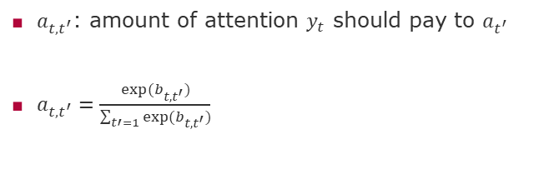


Computing Attention
$a_{t,t^{′}}$: amount of attention $y_{t}$ should pay to $a_{t^{′}}$
$a_{t,t^{′}}=\frac{exp⁡(b_{t,t^{′}})}{\sum_{t′=1}{exp⁡(b_{t,t^{′}})}}$
$$S_{t−1}$$
$$a_{t^{′}}$$
$$b_{{t,t}^{′}}$$
Attention Mechanism

Slide 6
Topics
Brief background on Attention Models
Attention models in Language Translation
Attention models in RNN
Graph Attention Models

Slide 7
Seminal work
Bahdanau, Dzmitry, Kyunghyun Cho, and Yoshua Bengio. "Neural machine translation by jointly learning to align and translate." arXiv preprint arXiv:1409.0473 (2014).
Xu, Kelvin, et al. "Show, attend and tell: Neural image caption generation with visual attention." International conference on machine learning. 2015.

Slide 8
Neighborhood Aggregation
Bahdanau, Dzmitry, Kyunghyun Cho, and Yoshua Bengio. "Neural machine translation by jointly learning to align and translate." arXiv preprint arXiv:1409.0473 (2014).

Slide 9
Next and Future Tasks
Compute and compare graph metrics (Wednesday, 2.12)
Any metrics and networks of your choice
First draft of abstract (Friday, 4.12)
Predictions using traditional method (Wednesday, 9.12)
Any two methods of your choice
Related work draft (Friday, 11.12)
Node and Graph Feature Learning (Wednesday, 16.12)
Any two methods of your choice
Design alternative pipelines for your GNN (Wednesday, 06.01)
Three alternative different options for embedding, aggregation, and enconding
Test at least one.

Slide 10
END

